Slide 1

Handwritten Digit Recognition System
Welcome to my presentation on a handwritten digit recognition system built with TensorFlow and Keras. I will cover the process from data loading to model creation and training, showcasing the power of machine learning in image classification. Get ready for a deep dive into the technology behind understanding handwritten digits!
Qudratullah Nezami
20222739
22020107056

Slide 2
The Power of Neural Networks
What is it?
Why is it important?
A handwritten digit recognition system uses neural networks to classify images of handwritten digits (0-9). The system takes an input image, processes it through layers of interconnected neurons, and outputs a prediction of the digit.
This project demonstrates the potential of machine learning for tasks like image classification. It serves as a building block for more complex AI applications, showing how computers can learn to 'see' and understand patterns.

Slide 3
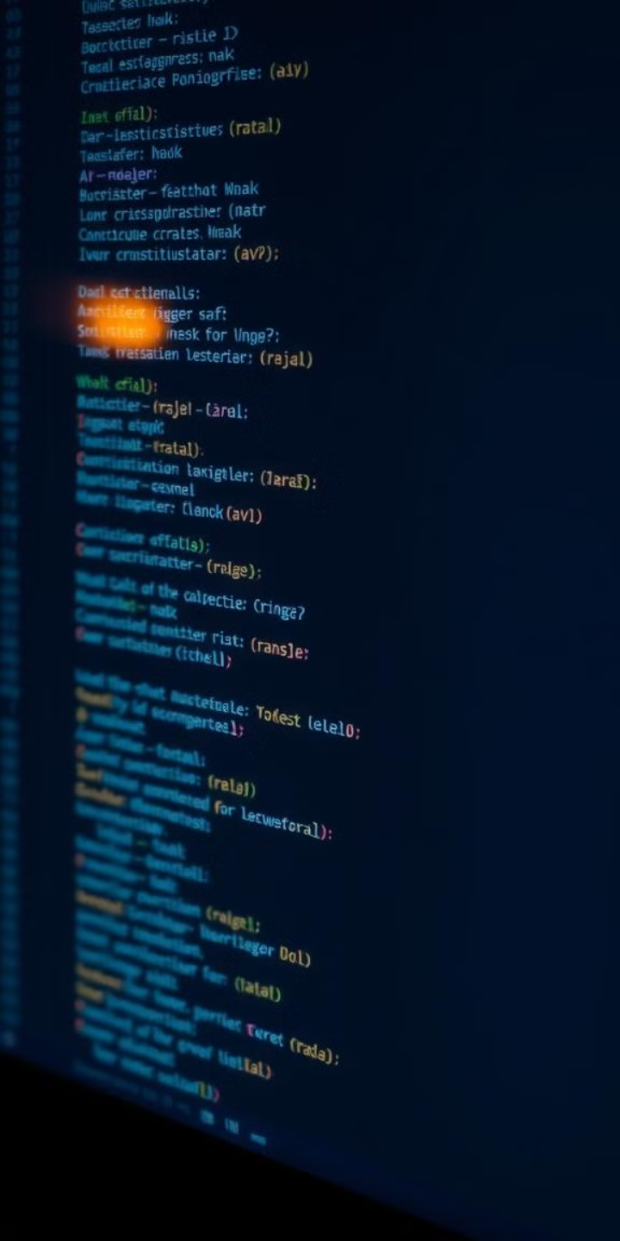


Data and Technologies
MNIST Dataset
Technologies Used
The MNIST dataset contains 60,000 training and 10,000 testing images of handwritten digits. Each image is 28x28 pixels, representing grayscale pixels from 0 (black) to 255 (white).
The system relies on Python for programming, TensorFlow/Keras for building the neural network model, NumPy for numerical computations, and OpenCV for image processing.

Slide 4
Code Explanation
1
Data Loading and Preprocessing
2
Model Creation
3
Training the Model
The MNIST dataset is loaded and split into training and testing sets. Normalization scales pixel values to a range of 0-1, which speeds up the training process and improves accuracy.
The model consists of a Flatten layer that converts the 2D images into 1D arrays, two Dense layers with 128 neurons and ReLU activation for feature extraction, and an Output layer with 10 neurons and softmax activation for classification.
The model is compiled with the Adam optimizer for weight adjustment, the sparse categorical cross-entropy loss function to measure prediction error, and accuracy metrics. The model is trained for 3 epochs, a balance between speed and accuracy.
Data Loading and Preprocessing
(x_train, y_train), (x_test, y_test) = mnist.load_data() x_train = tf.keras.utils.normalize(x_train, axis=1) x_test = tf.keras.utils.normalize(x_test, axis=1)
Model Creation
model = tf.keras.models.Sequential([
tf.keras.layers.Flatten(input_shape=(28, 28)),
tf.keras.layers.Dense(128, activation='relu'),
tf.keras.layers.Dense(128, activation='relu'),
tf.keras.layers.Dense(10, activation='softmax')
])

Slide 5
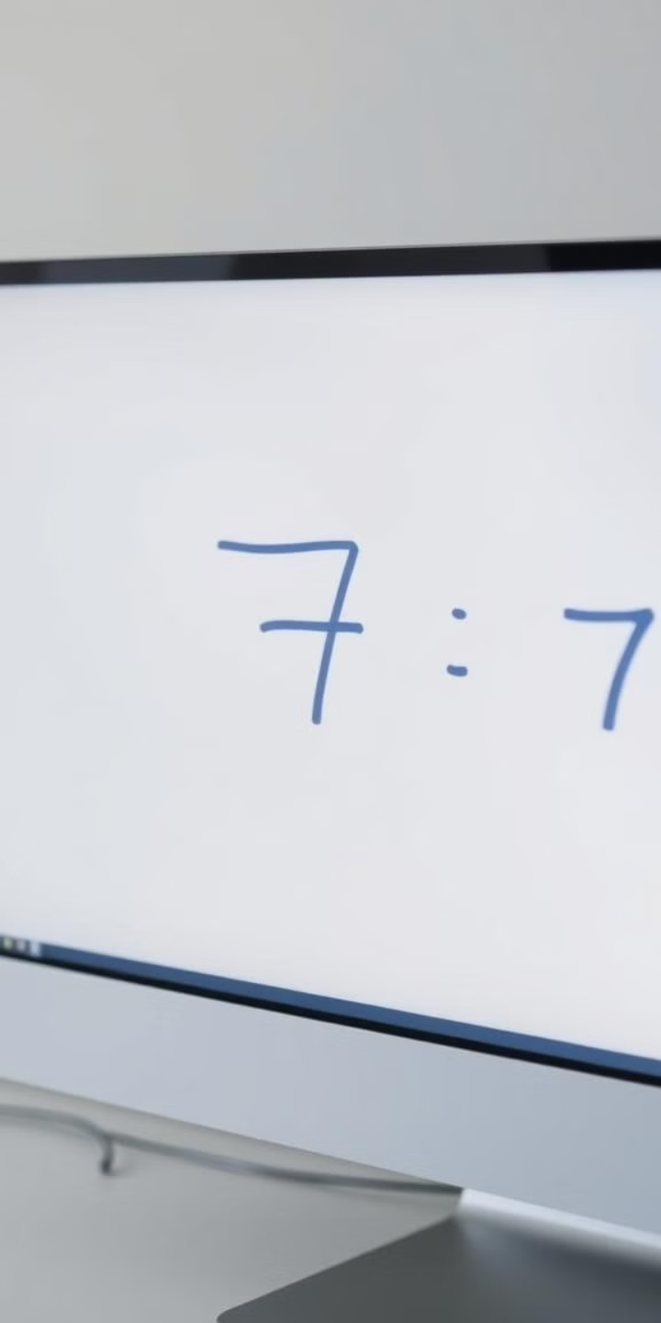
Model Performance and Sample Prediction
97-98%
1
Accuracy
Prediction
The model achieved a high accuracy of 97-98% on the testing dataset, demonstrating its ability to effectively classify handwritten digits.
A sample image is loaded, processed by inverting pixels for consistency, and fed into the model for prediction. The model outputs the predicted digit based on its learned patterns.

Slide 6
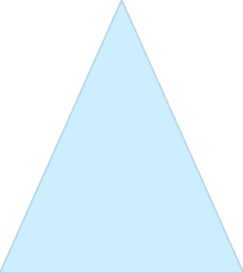


Future Enhancements
Accuracy Improvement
Implementing Convolutional Neural Networks (CNNs) can further enhance accuracy by focusing on spatial relationships in images, leading to more robust feature extraction and potentially higher performance.
1
Usability Enhancements
Adding a batch prediction feature allows processing multiple images simultaneously, improving efficiency. A user-friendly GUI or web application can make the system more accessible and intuitive for users.
2
Scalability
3
Expanding the model to handle other datasets opens up possibilities for alphanumeric recognition, broadening its applications and potential impact.

Slide 7

Conclusion
This presentation demonstrated the potential of machine learning for digit recognition. The system achieved a reliable and scalable solution, paving the way for future innovation in the field. Thank you for your time!

